Slide 1
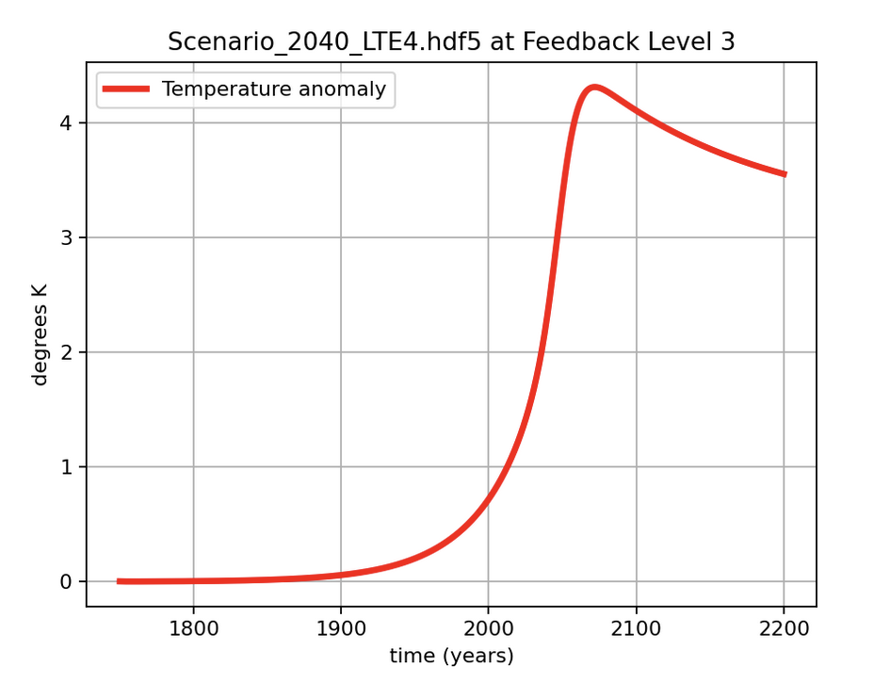
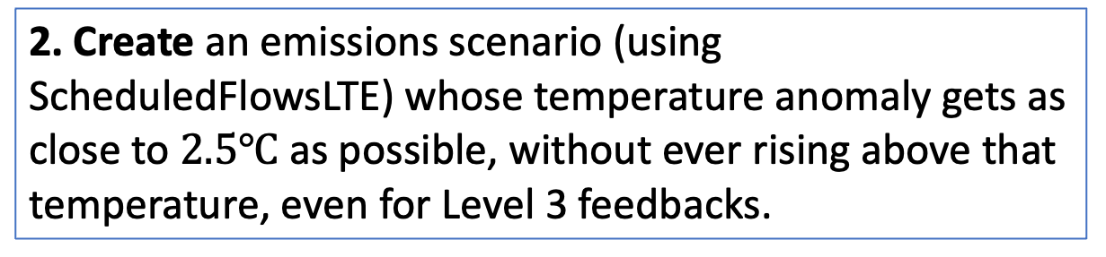
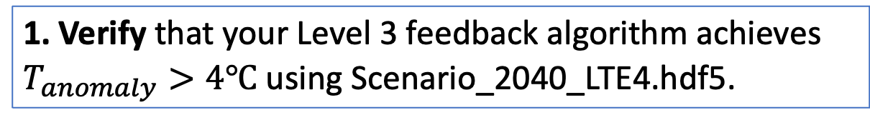
In the last “Pause for Analysis” of Cambio3.0, don’t forget these steps …
1. Verify that your Level 3 feedback algorithm achieves $T_{anomaly}>4℃$ using Scenario_2040_LTE4.hdf5.
2. Create an emissions scenario (using ScheduledFlowsLTE) whose temperature anomaly gets as close to $2.5℃$ as possible, without ever rising above that temperature, even for Level 3 feedbacks.
3. Resubmit Cambio3.0 with that happy scenario in your Cambio3.0 folder.

